Slide 1
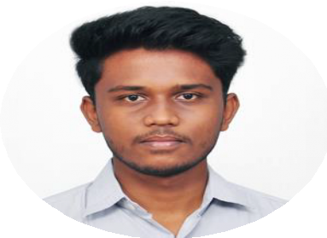







Career Objective
Looking for the opportunities to secure the position where I can employ my skills and to expand my knowledge and responsibilities for the growth of the company.
Address:
No:55,Vippedu Village, Kanchipuram-631502
Phone:
E-mail: Linkedin:
+918940016120
shamchris29@gmail.com https://www.linkedin.com/in/sham
-christopher-a3783b211
A.Sham Christopher
LTIMINDTREE:
ROLE: Cloud/Infra engineer
Duration: Sep 2024 – Present
Project: CITI Bank
CI/CD Implementation : Worked on continues integration using Jenkins, Bitbucket, Artifactory integrating with BMC RLM for continuous deployment.
API Testing: Performed manual and script-based testing for REST APIs to ensure functionality and reliability
Automation & Deployment: involved in automating build, deployment, and release process to streamline software delivery.
Personal Information
Father’s name: Mr.P.Anthony Doss
Date of Birth: 29/09/2001 Languages known: English , Tamil
Work experience
Self Efficacy: | Quick Learner Leadership | Logical Adaptability
Hobbies: | Badminton Cricket | Music Editing
Industrial Exposure
Industrial visit:
Bharat Sanchar Nigam Limited (A Govt. Of India Enterprise) Chennai Telephones, Periyar salai, Marai Malai nagar (2019).
Infoziant PVT LTD, T-Nagar (2020) Inplant Training:
SRIP IITGN Internship program on Android Apps (2021)
Webinars:
Attended webinar on IOT
Attended webinar on 3-D printing
Educational Qualification
B.Tech Information Technology SRM Valliammai Engineering College CGPA- 8
H.S.C
Infant Jesus Mat.Hr.Sec.School, Kanchipuram (2017-2018) 83.8% SSLC
Infant Jesus Mat.Hr.Sec.School, Kanchipuram (2015-2016) 92.8%
Areas Of Interest
Web Designing App Development
Technical Skills
Cyber Security AI
Programming Skills : Python , Java C Programming, Shell scripting.
Web designing: HTML,XML
Certifications
Python Programming, REST API Testing
Digital Marketing (Google Unlocked)
Membership: Indian Society for Technical Education Computer Society of India

